Slide 1

GOOD MORNING !!!!!!

Slide 3
Education System In Nepal…………….!!

Slide 4
Table of Contents : -
Introduction
Dark Side
Effect in Mental Health
Education Mafia
Effects of Education Mafia
Conclusion

Slide 5
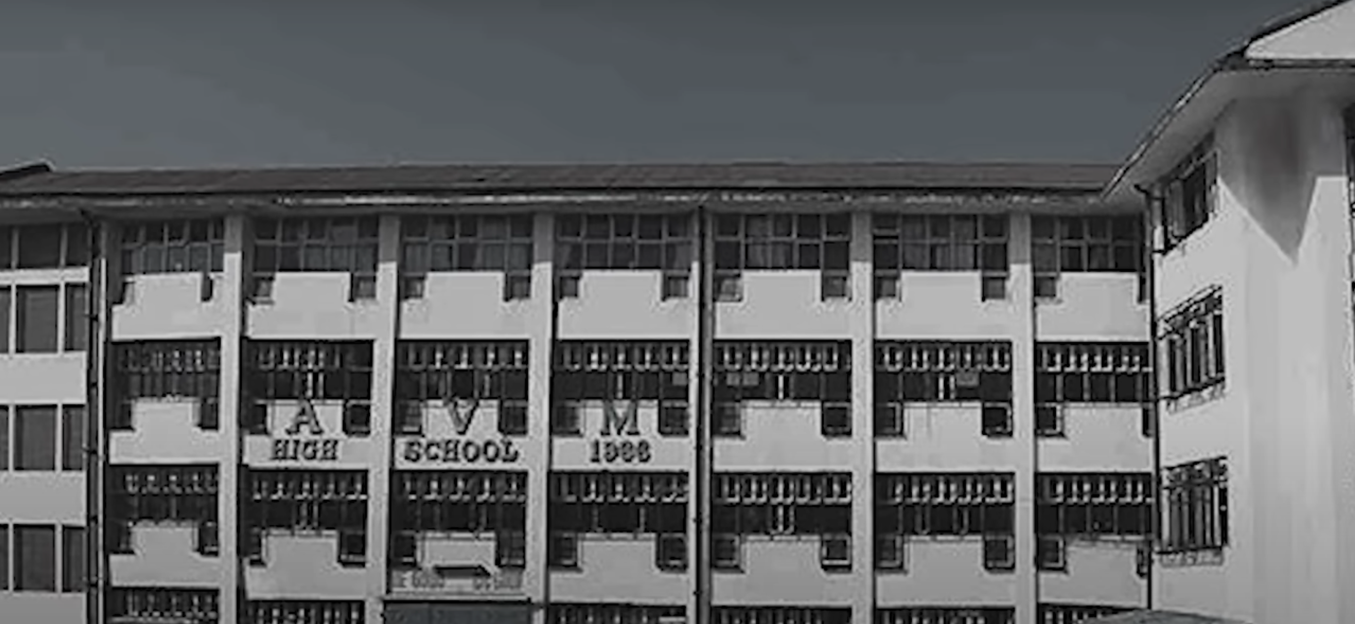
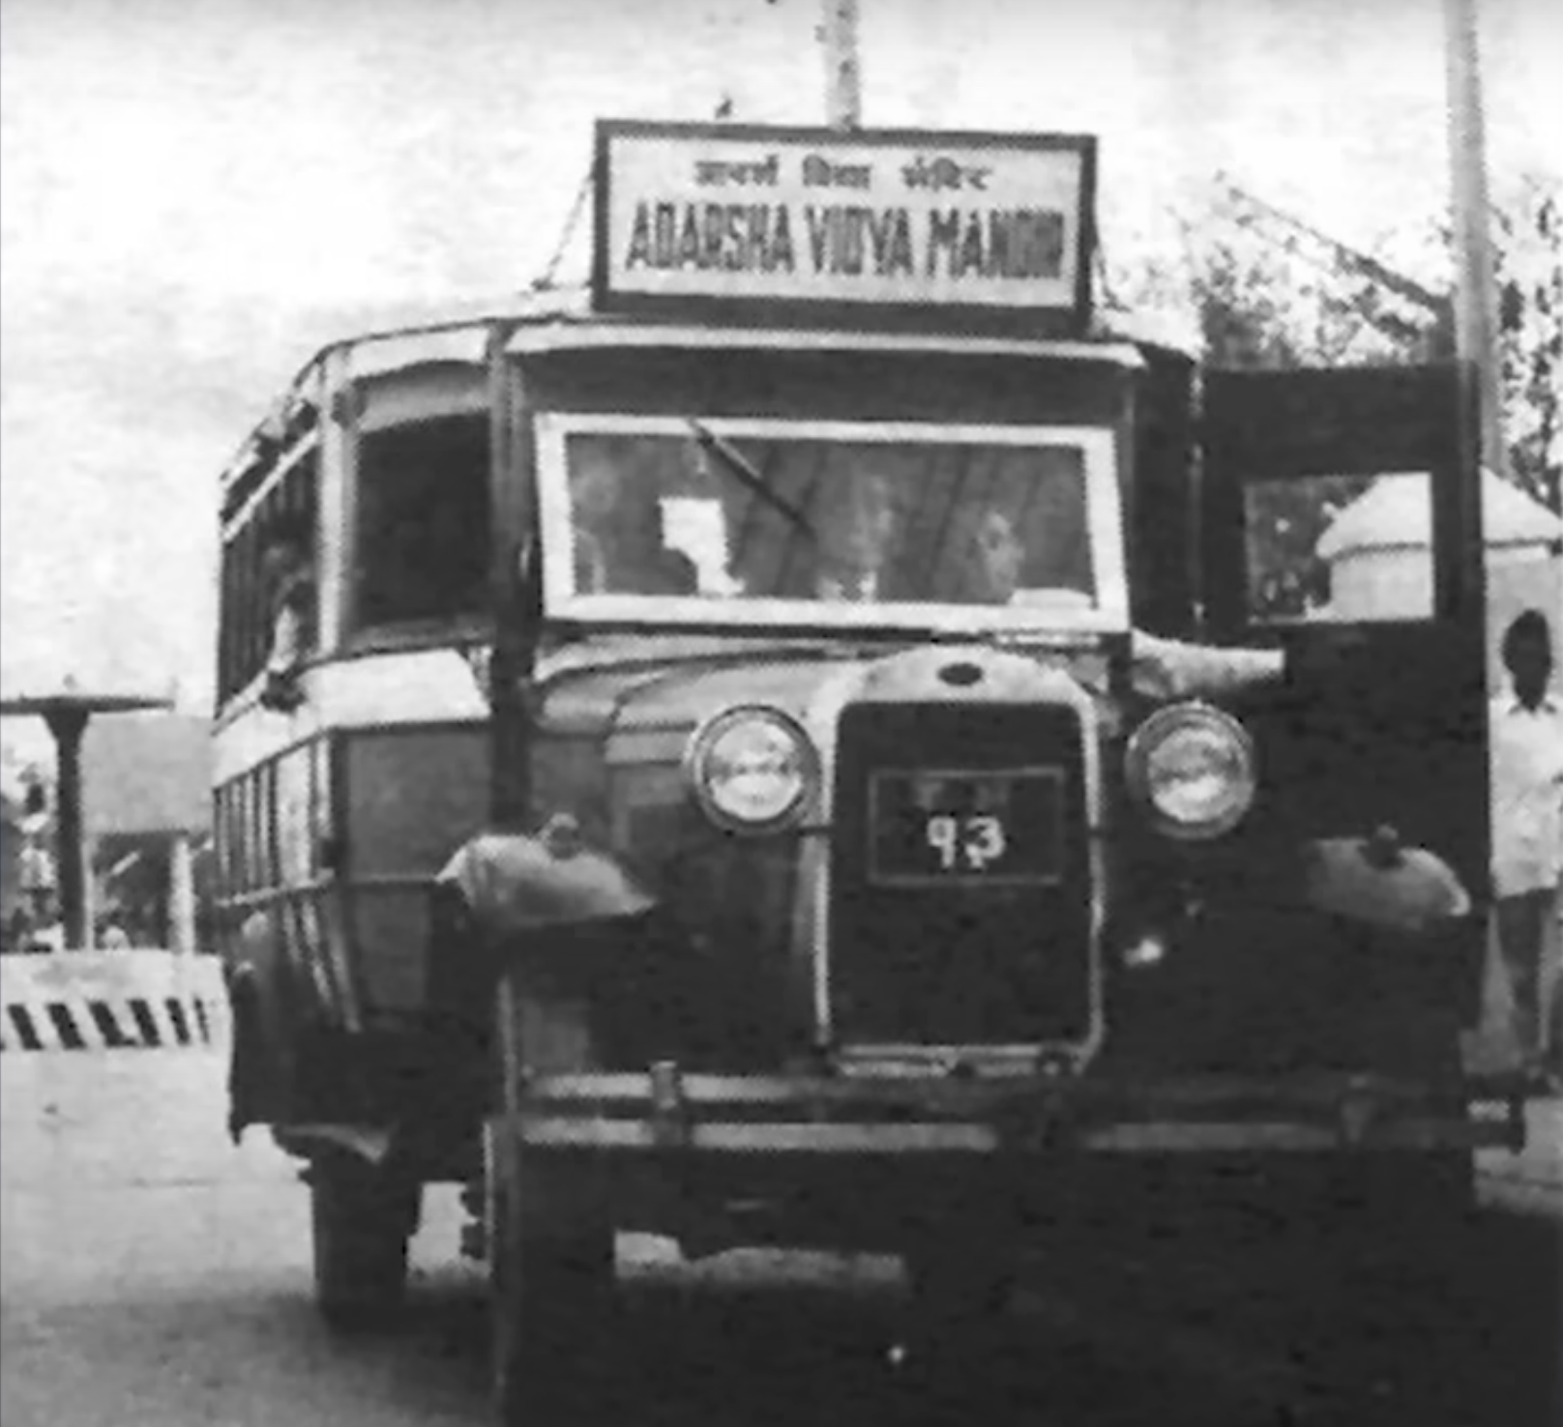
INTRODUCTION :
The first school of Nepal is Durbar High School which was established in B.S 1910. The first private school of Nepal is Adarsha Vidya Mandir(AVM) in B.S 1966. Till then only Royal family were allowed to get education but AVM school was opened to provide education to common people.
Fig. First School Bus
Fig. First Private School

Slide 6
DARK SIDE :
The education system in Nepal is plagued by a number of issues that have hindered its growth and development. These issues include lack of resources, lack of funding, and lack of infrastructure. Specially, the lack of a well-developed curriculum and the lack of skilled teachers have contributed to the problems in the education system in Nepal. This has led to a large number of students dropping out of school and not receiving the education.
The lack of resources, funding, and infrastructure has also led to a lack of quality education in Nepal. Many students are not receiving the quality education they need to become successful in life. This has led to a lack of job opportunities for students who have graduated from the education system in Nepal. Additionally, the lack of quality education has resulted in a lack of social and economic development in Nepal. This has resulted in a large number of people living in poverty and not being able to access the resources they need to improve their lives.

Slide 7
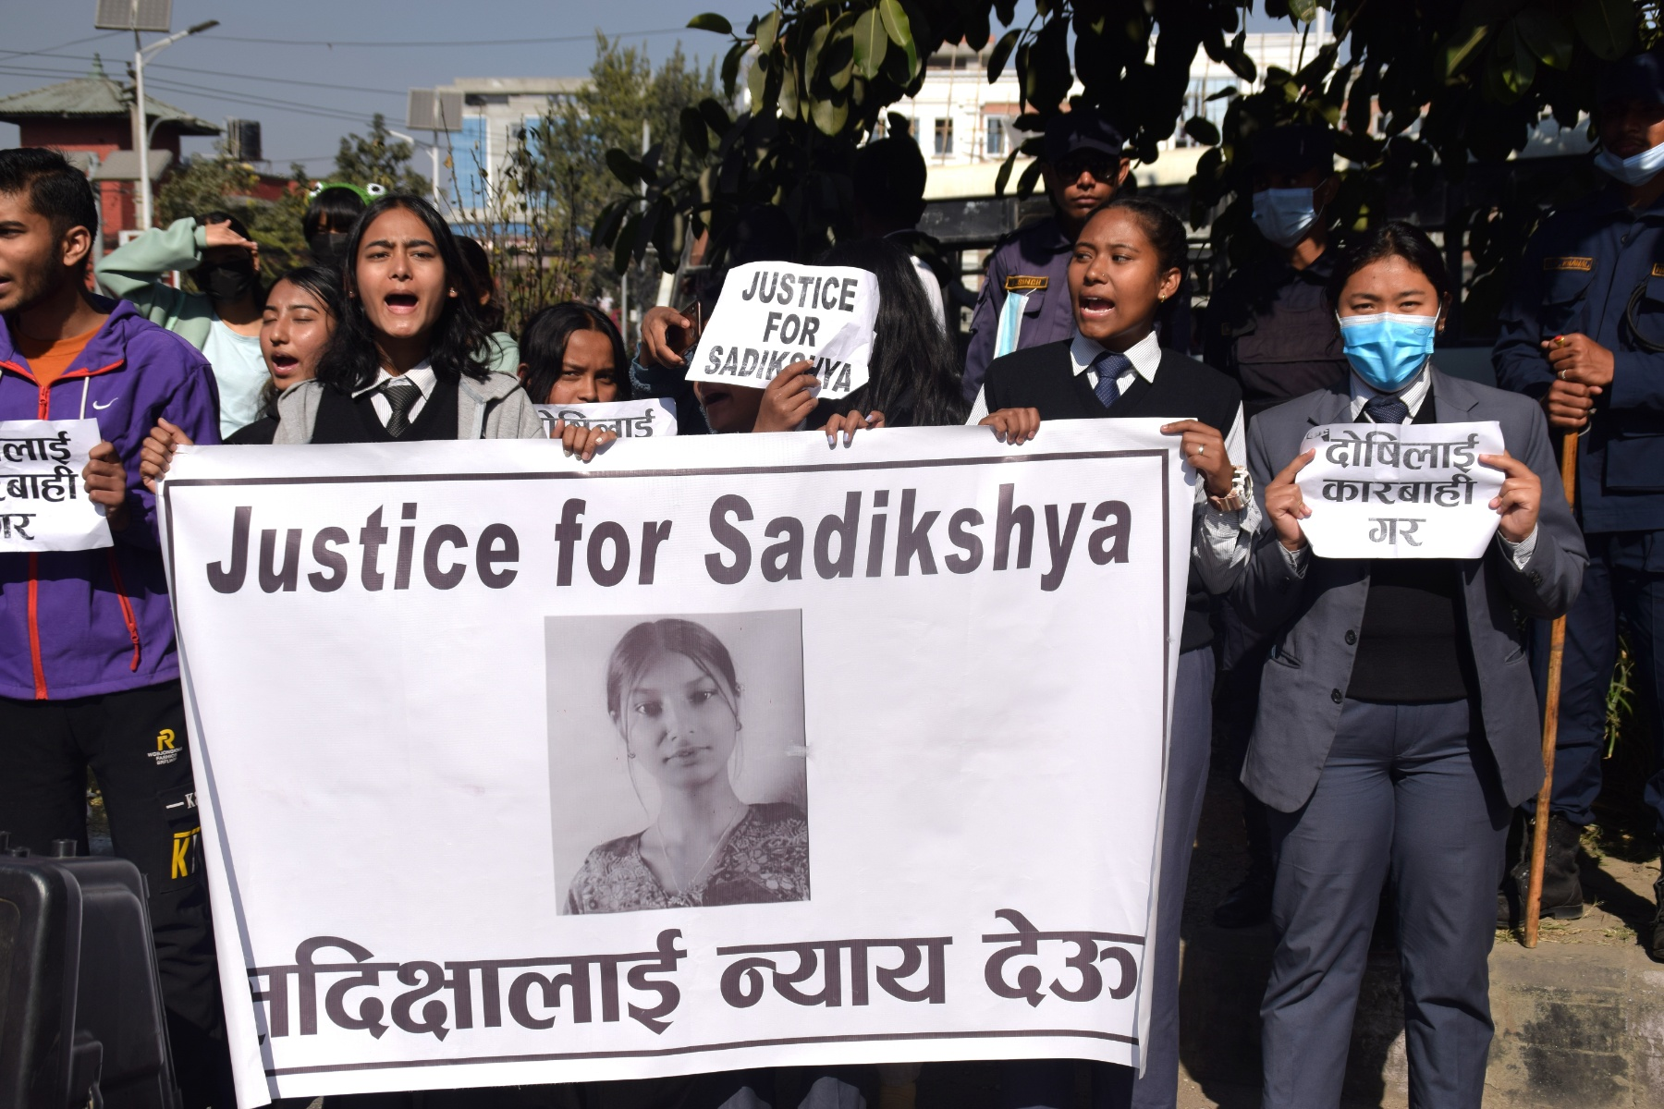
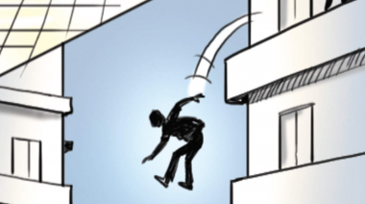
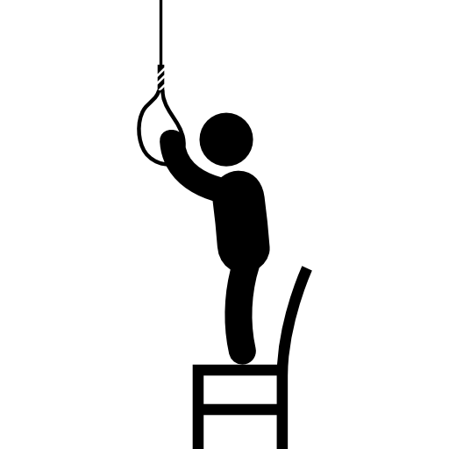
EFFECT IN MENTAL HEALTH :
Students take to the streets demanding justice for Sadiksha Chaudhary.
2 students studing at ninth grade in Pathshala Nepal, jumped form sixth floor of under construction building still in the school dress.
In sucide note they mention that they did met their parent expectation.
See result negligence..

Slide 8
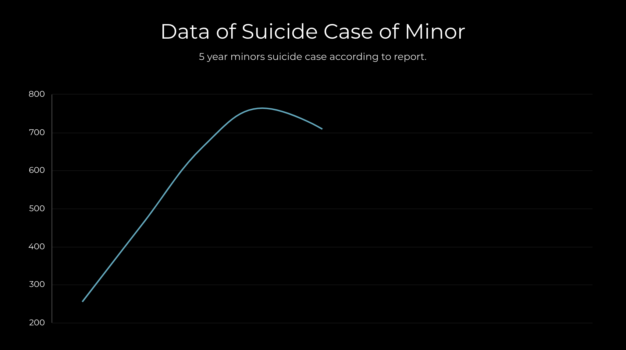
According to Nepal Police’s data of the past five fiscal years, the number of suicides among minors has been escalating. There were a total of 255, 459, 661, 764, and 709 suicides among minors in the fiscal years 2017/18, 2018/19, 2019/20, 2020/21, and 2021/22 respectively.

Slide 9
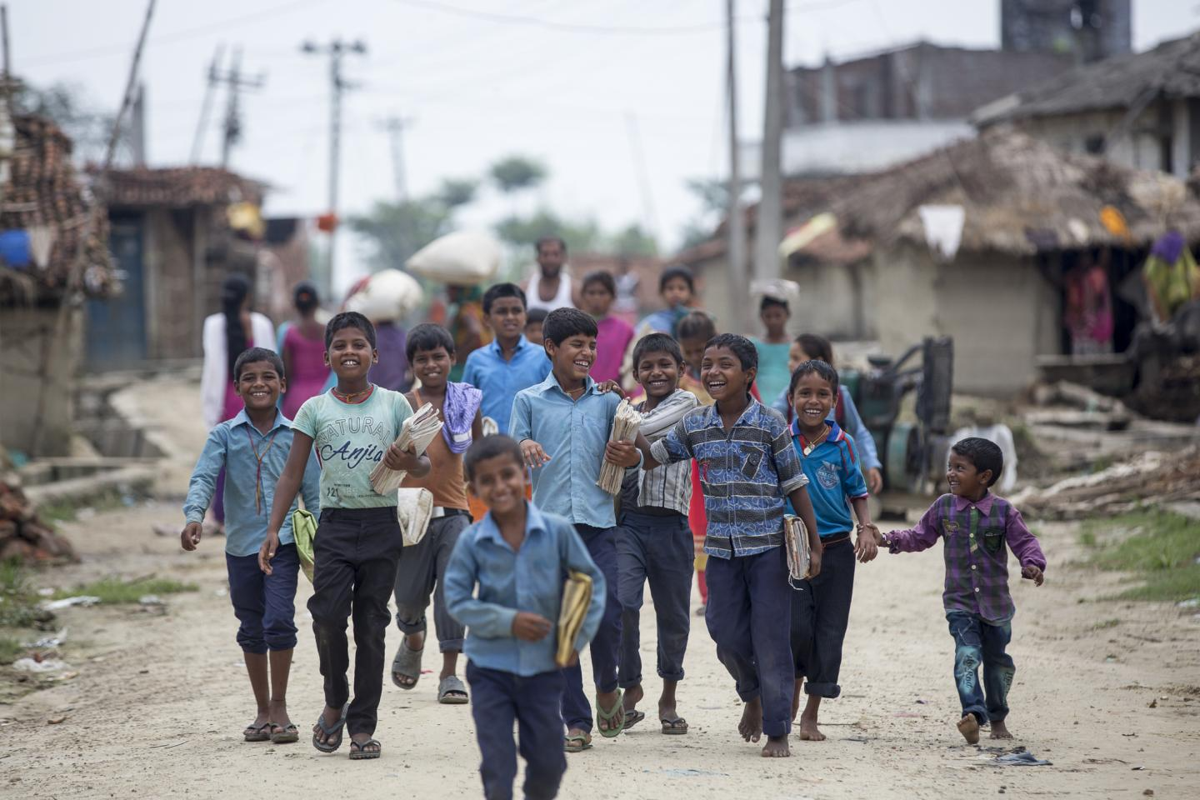

EDUCATION MAFIA :
GOVERNMENT SCHOOL(26,454) V/S PRIVATE SCHOOL(6,760)

Slide 10
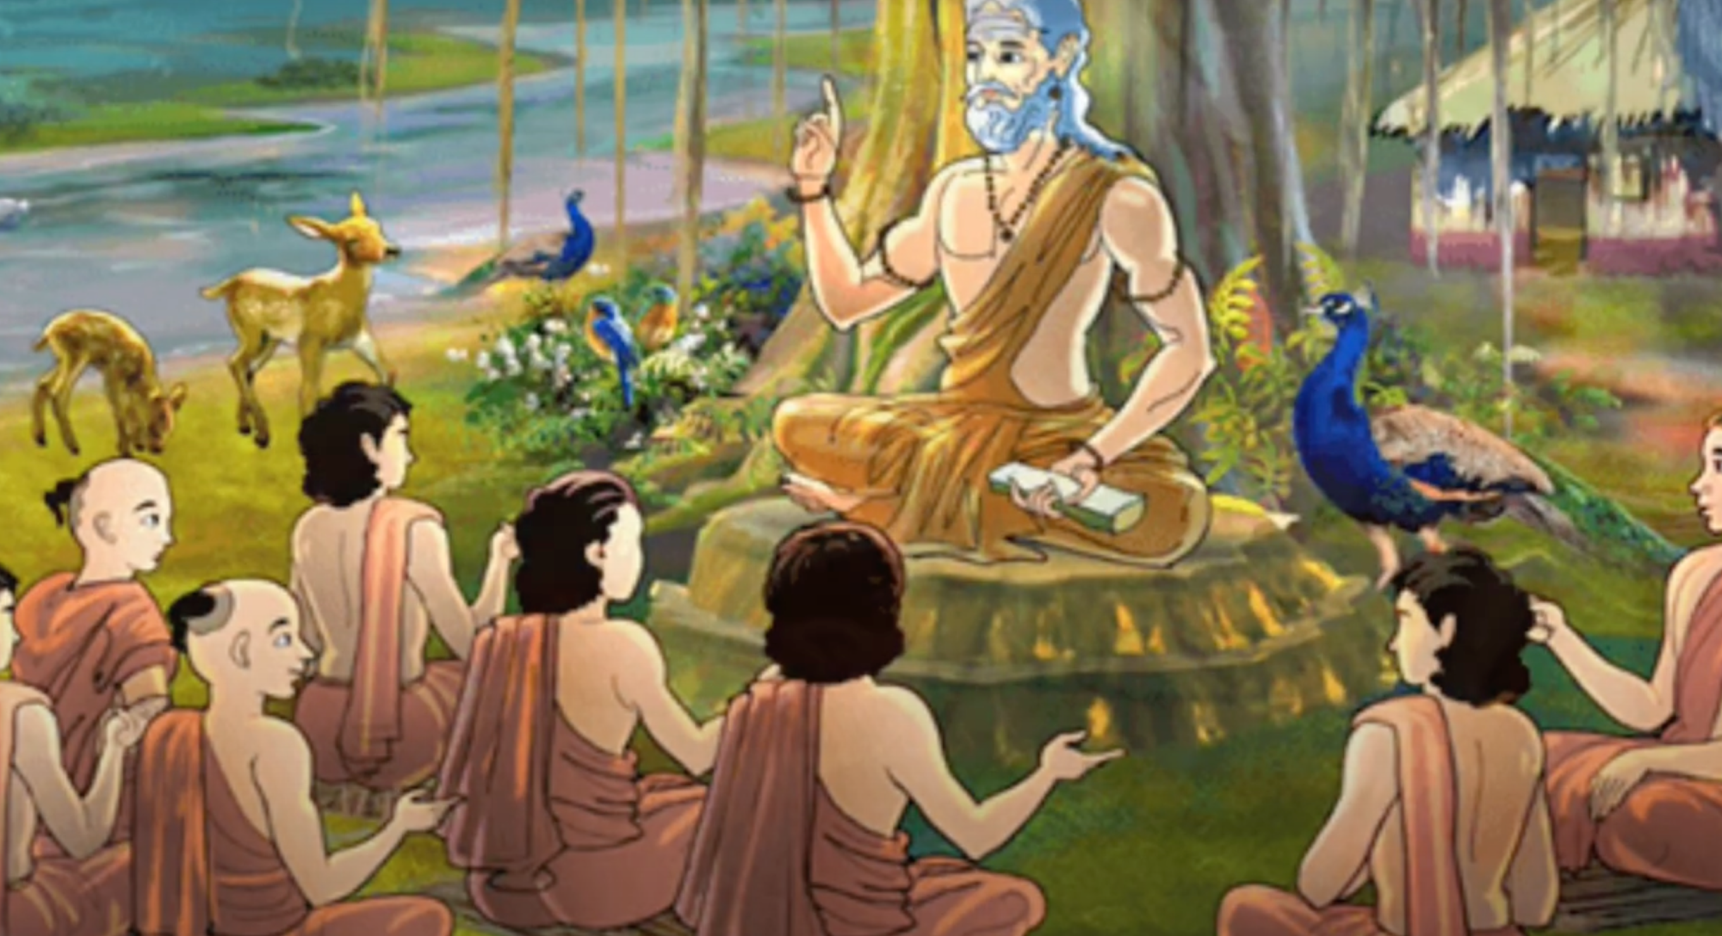
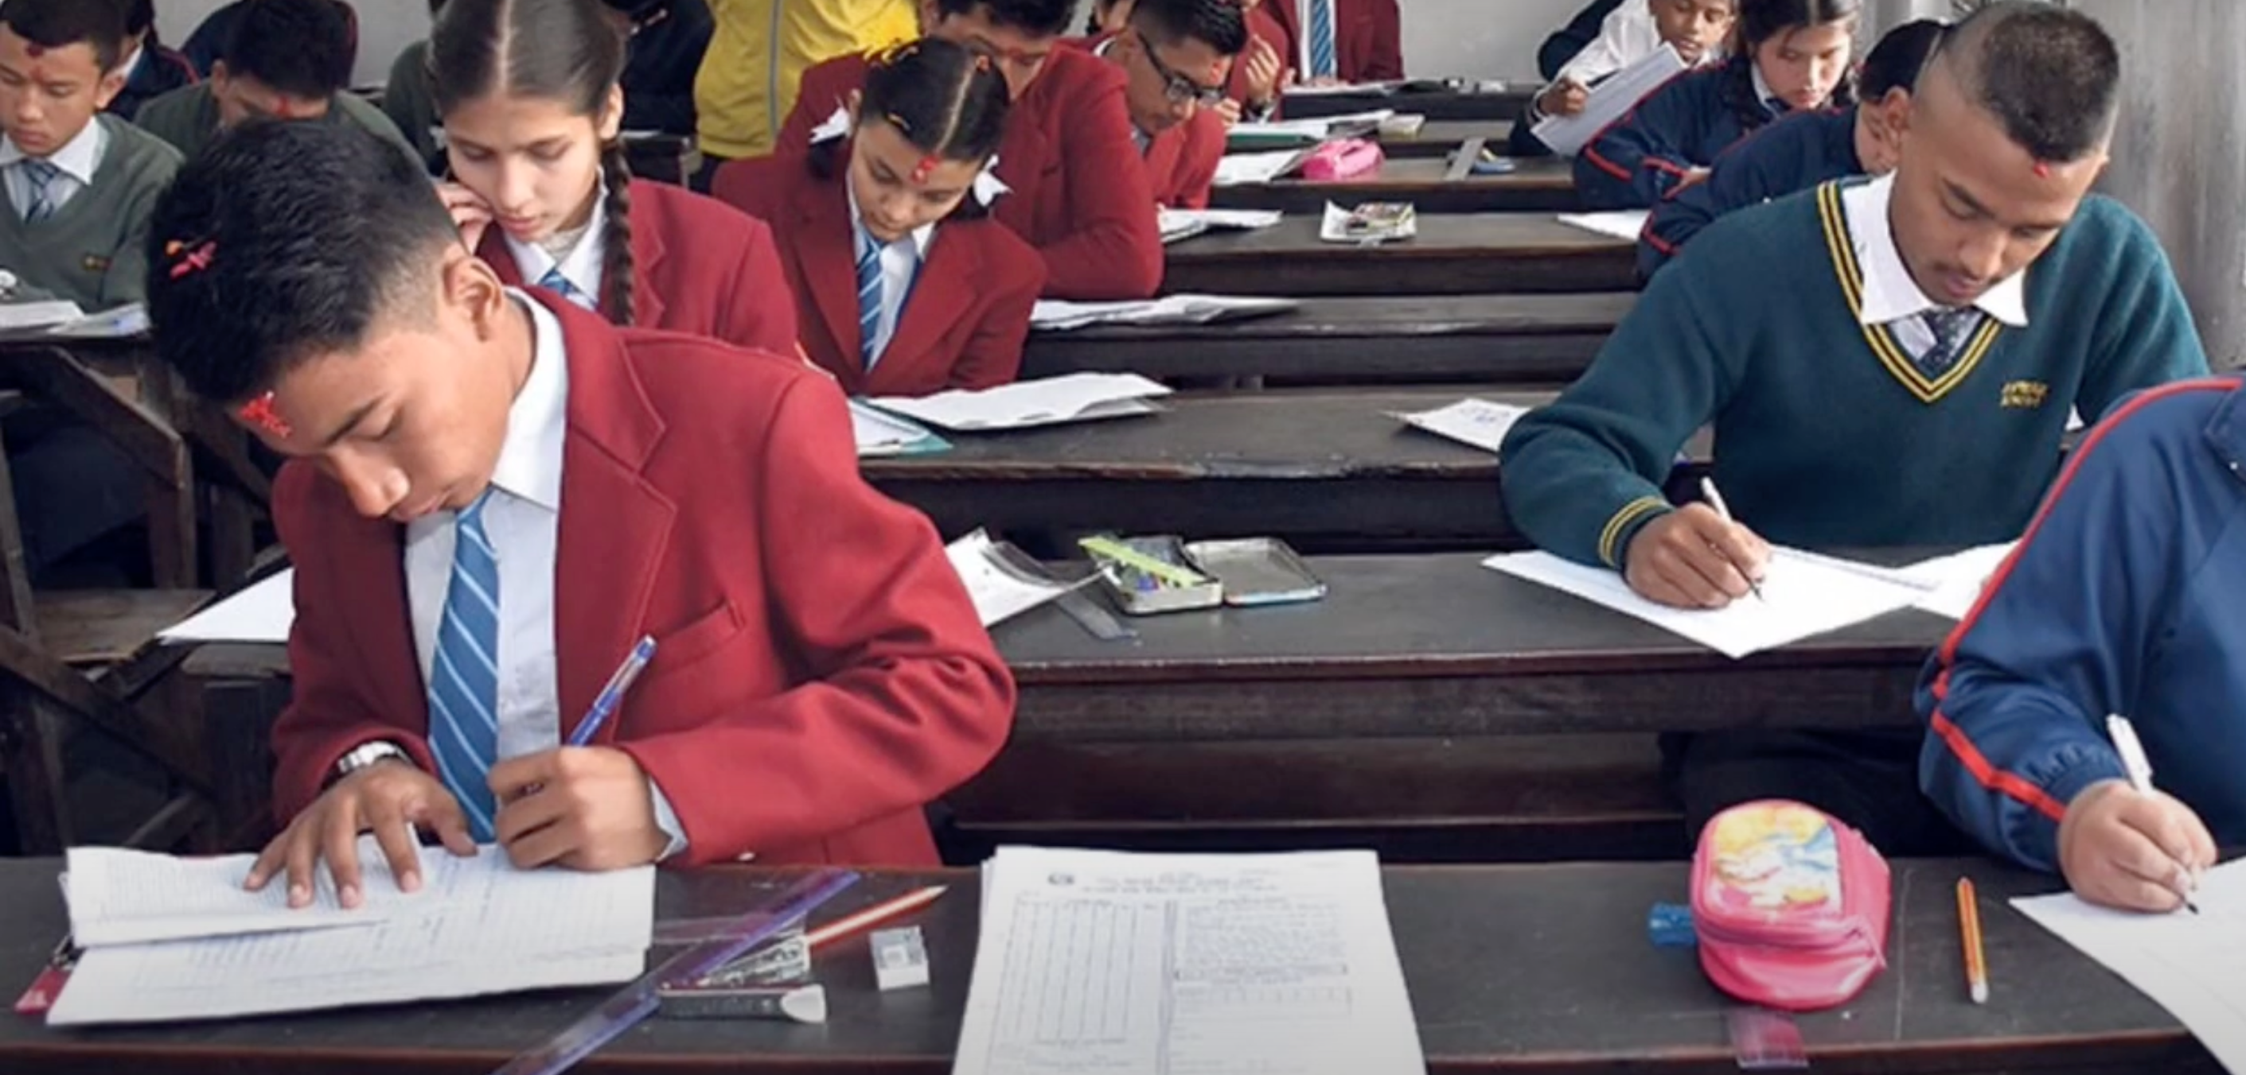
Difference in education system

Slide 11
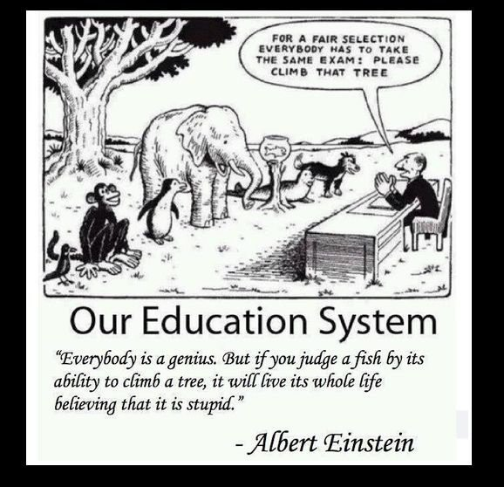
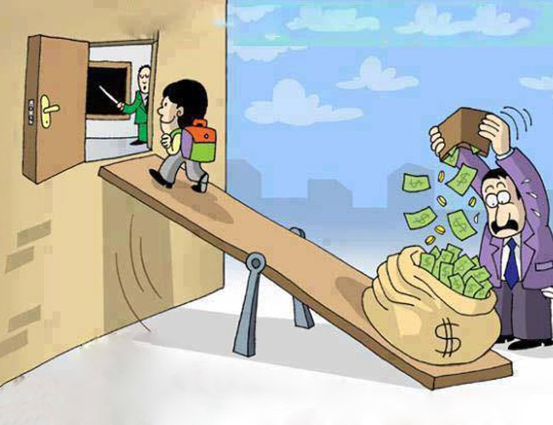
EFFECTS OF EDUCATION MAFIA :
Dominance of Private Sectors.
Expensive fee.
Academic Jail.
Good education is expensive.

Slide 12
CONCLUSION :
“ I don’t want the nation of thinkers, I want the nation of workers..” --- John D. Rockefeller
Education is the right of the every individual but it feels like burden due to dark side of the education system.
We learn about different rights i.e. the right to entertainment, and to speech through a text from a secondary level but many institutions prohibit the same right from their students.

Slide 13
Is There Still A
Hope?

